Slide 1
DCAITI-Project: Street damage detection and rating
Name: Yilei Chen, Yiying Yang, Jie Chen
Betreuer: Tschinibaew, Iskander

Slide 2
Agenda
I.Previous Overview
i. Task Descriptions
ii. Dataset
iii. Timeline
II. Implementation
i. Shapefile and ZEB image dataset
ii. Preprocessing(GRDDC dataset)
iii. Road Damage Detection
iv. Preprocessing(ZEB_dataset)
vi. Scoring model
III. Conclusion & Outlook
Speaker: Yiying Yang

Slide 3
I.Previous Overview
i. Tasks Descriptions
Select ZEB image dataset according to the shapefile.
Use Global Road Damage Detection Challenge 2020 Dataset to train object detection model.
Detect damage on ZEB image dataset through the model.
Create a rating that correlates to the score annotated in the shapefile.
Speaker: Yiying Yang

Slide 4
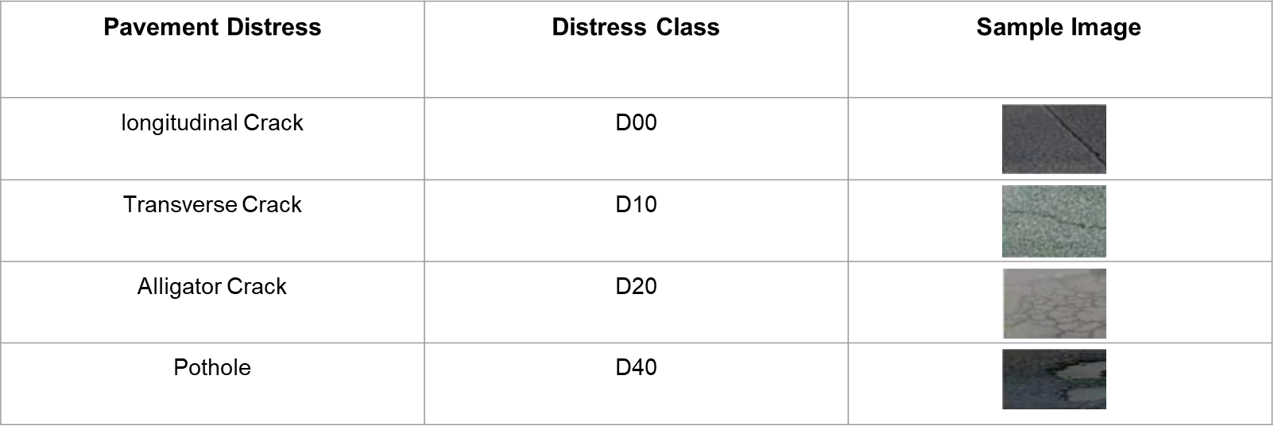
II. Implementation
ii. Dataset
1. Global Road Damage Detection Challenge 2020.[1]
2. ZEB image dataset
Speaker: Yiying Yang
6

Slide 5


I.Previous Overview
iii. Timeline
 | April 2022 | May 2022 | June 2022 | July 2022
Phase Initialization
Planning the implementation of tasks
Familiarization with the theme
Phase Concept & Realization
Familiarity with Yolo v5 and transfer learning
Data pre-processing
Implementation of Yolo v5 and transfer learning
Phase Realization & Evaluation
Evaluation of the results
Create rating
Phase documentation
Completion of the documentation
Speaker: Yiying Yang

Slide 6
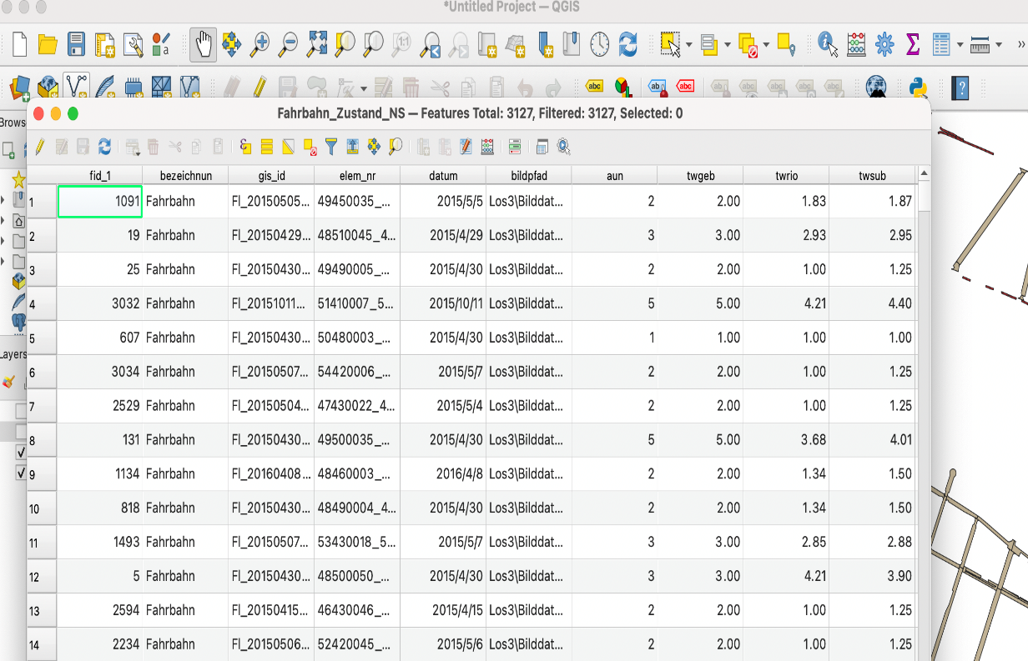
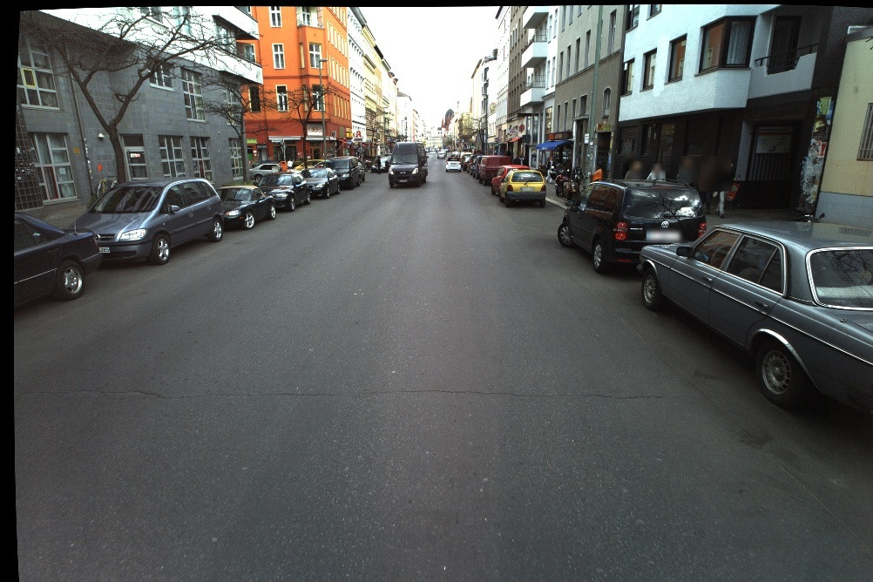
II.Implementation
Shapefile and ZEB image dataset
Select part of the streets of the Friedrichshain Kreuzberg as ZEB image dataset according to the shapefile.
ZEB image dataset pre-processing for YOLO
Renaming images
Place images in the same folder
Resize images
Attributes and values of shapefile
Speaker: Yiying Yang
Streets of Friedrichshain Kreuzberg

Slide 7
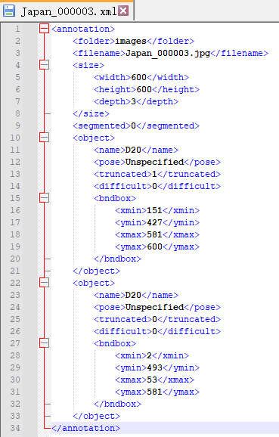
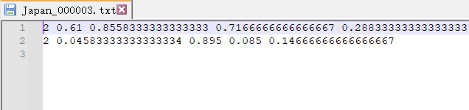
II. Implementation
ii.Preprocessing (GRDDC dataset)
● Split GRDDC dataset into train and validation sets (split_ratio=0.8)
● Convert the GRDDC data VOC format to YOLO
● Select images according to the shapefile
yolo format
Speaker:Yilei Chen:
voc format
Notes:
Now i will talk about the part of road damage detection. As we choose Yolov5 as our model, before training we did preprocessing on GRDDC datasets. First we randomly split the dataset into training and validation sets by ratio 0.8. Then convert the data format from VOC to YOLO and also select images according to the shapefile, cuz the data in shapefile is incomplete and we only choose images that exist in shapefile.

Slide 8
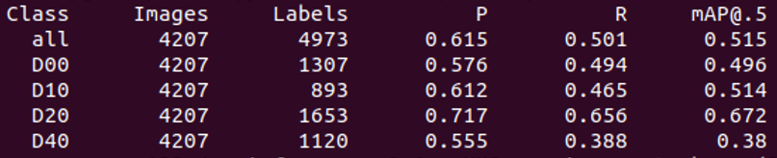
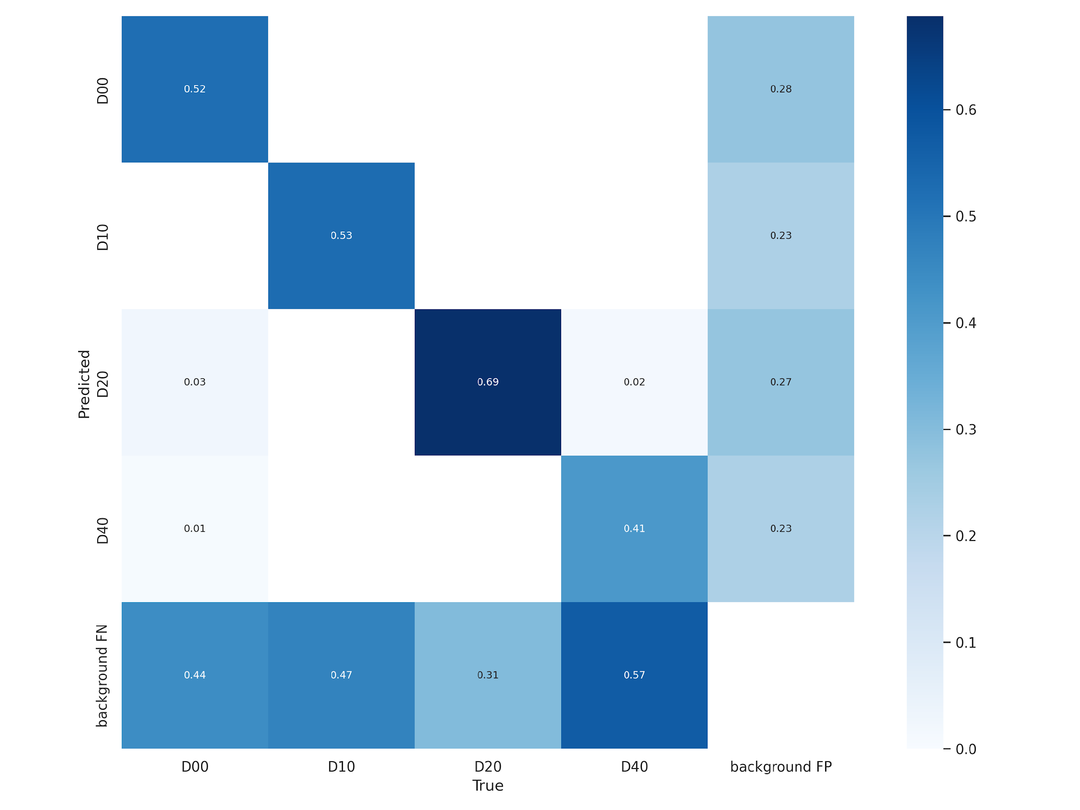
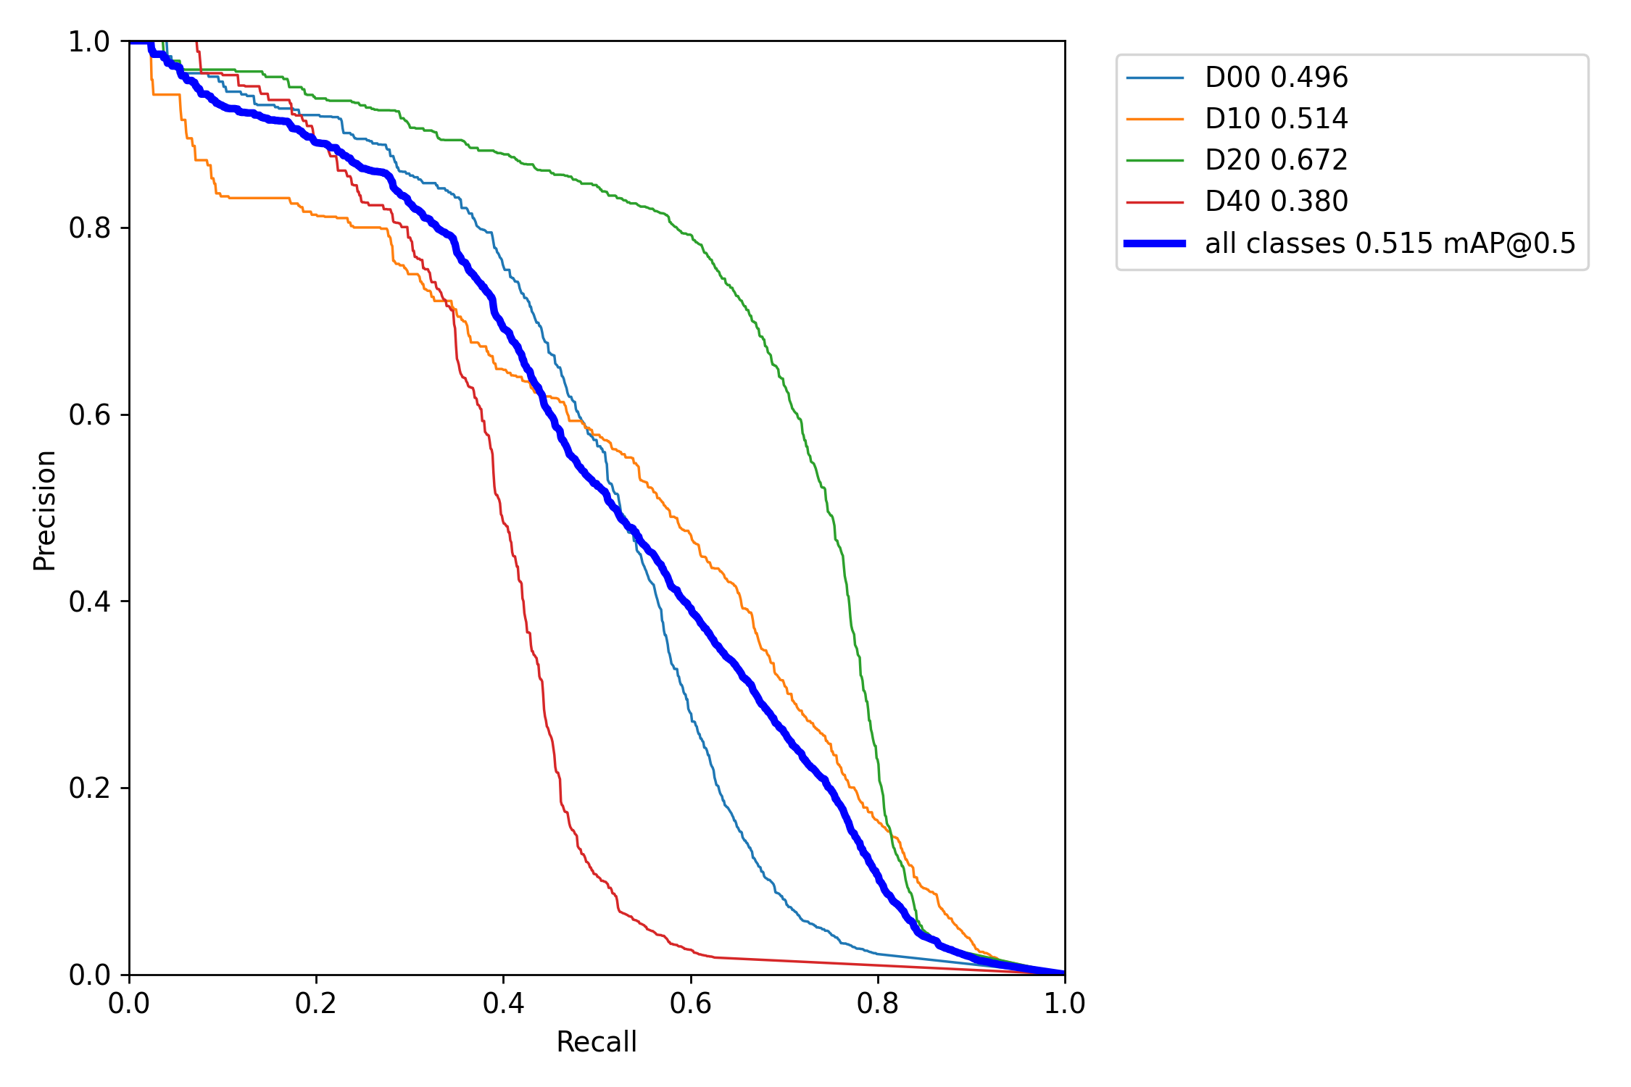
II. Implementation
iii. Road Damage Detection
● Model Comparison (Evaluated on validation set of DRDDC)
- Yolov5s (times consume: 66.153s)
confusion_matrix
PR_curve
Speaker:Yilei Chen
Notes:
As we have trained the datasets in 2 different model, yolov5s and yolov5x. Here i will show their corresponding training results which are evaluated on validation set and compare them. As we can see in the confusion matrix,The data on the diagonal line represents the rates of correct prediction,but we can find out there are still a large part of road damages that are mispredicted as background. About the evaluation indices, the mAP here is only 0.5 which is of course not good enough.

Slide 9
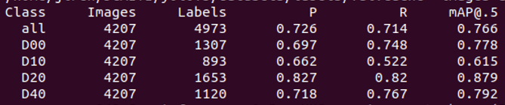
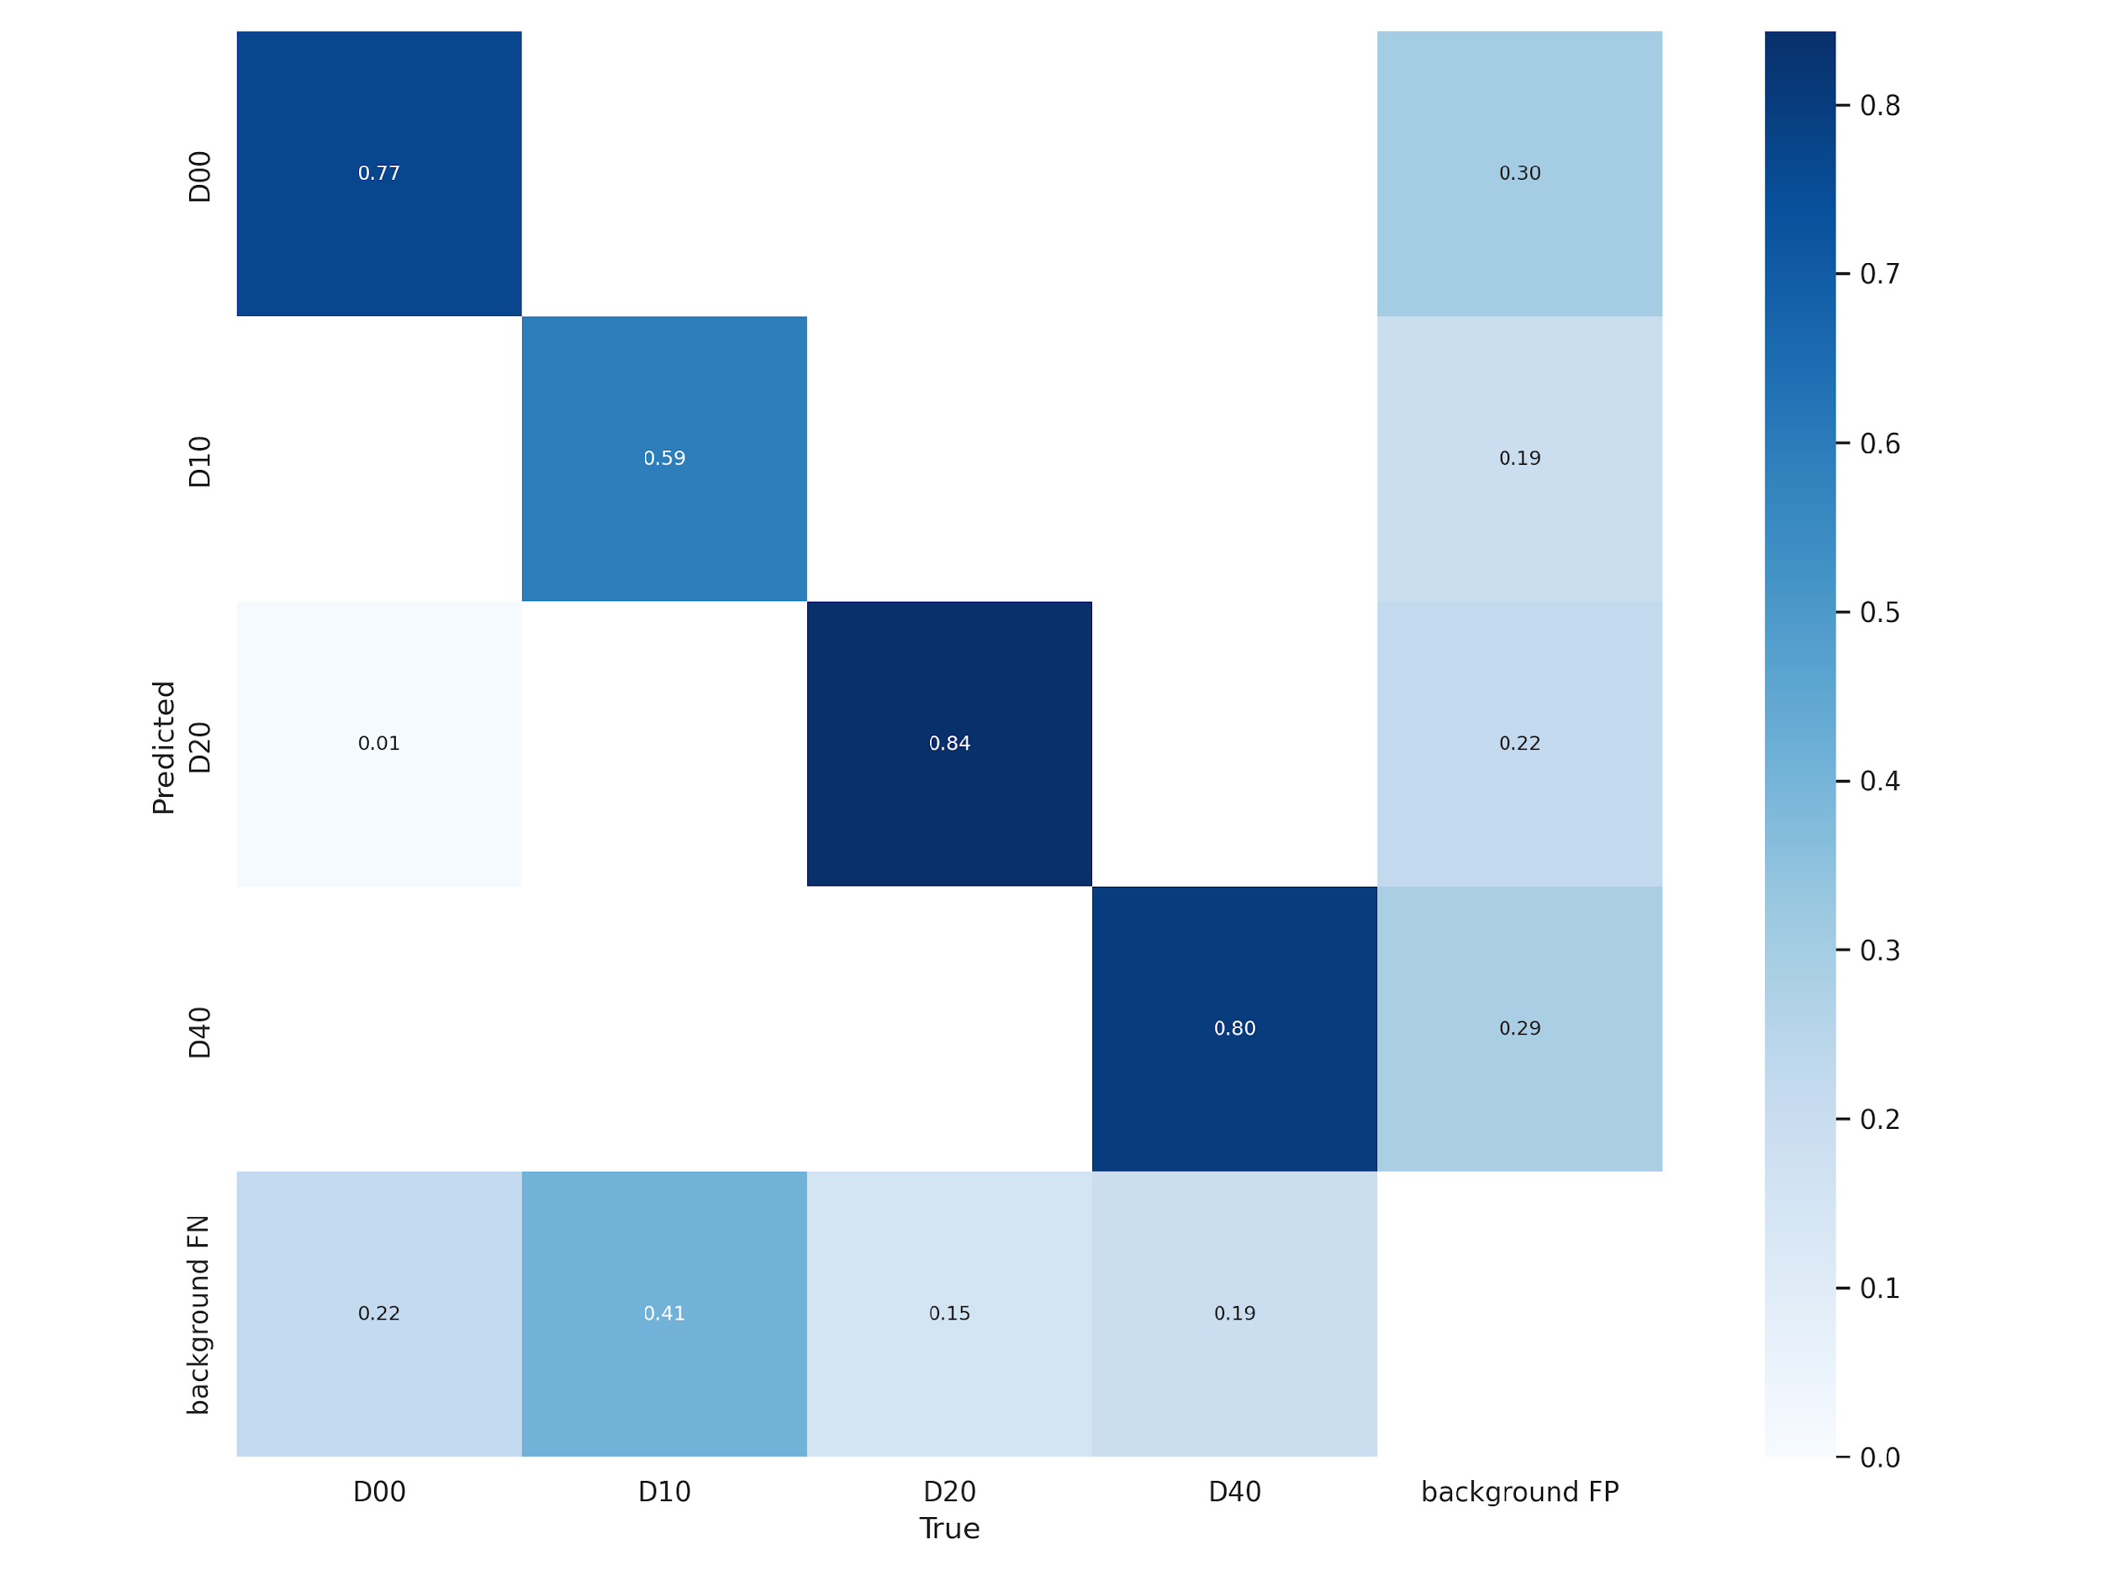
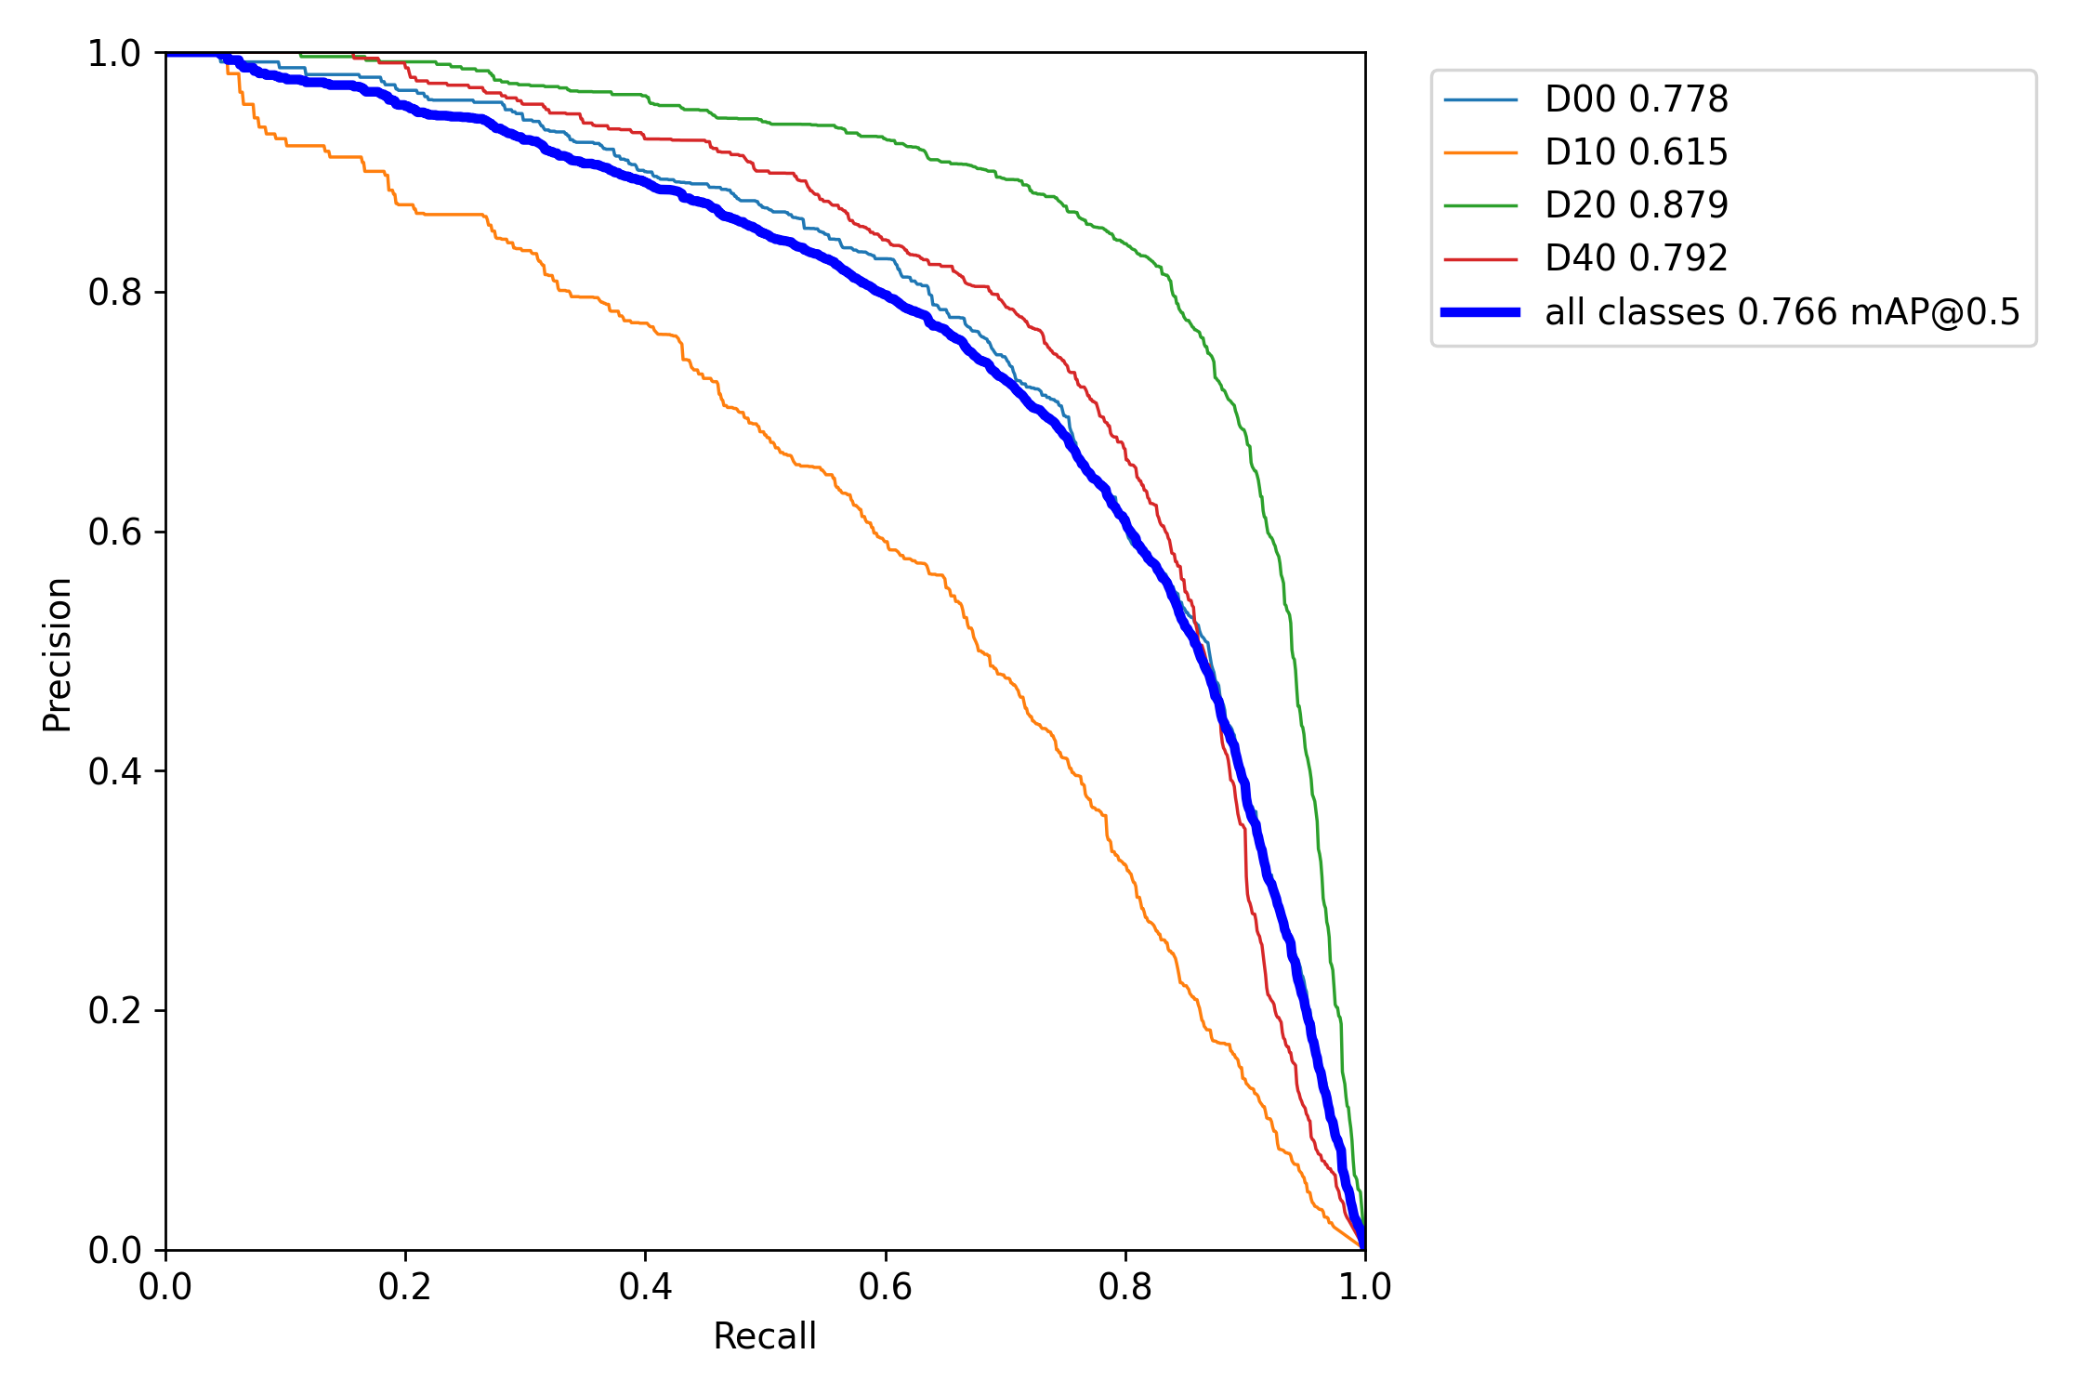
II. Implementation
iii. Road Damage Detection
● Model Comparison (Evaluated on validation set of DRDDC)
- Yolov5x (times consume: 426.556s)
confusion_matrix
PR_curve
Speaker:Yilei Chen
Notes:
As for Yolov5x, it performs much better than yolov5s, The prediction accuracy are all around 80% except damage type D10 which is only 59%. Beside, the mAP here reach 0.76 which is relatively acceptable. However Yolov5x is more time-consuming than v5s. In conclusion YOLOv5x has high accuracy, but slow detection speed. YOLOv5s has fast detection speed, which is over 6 times faster than YOLOv5x here.So it require less computation and can better meet real-time requirements, is easier to deploy on mobile terminals, and is conducive to product deployment.In this project, we used yolov5x as our final model cuz we need to guarantee the detection accuracy.

Slide 10
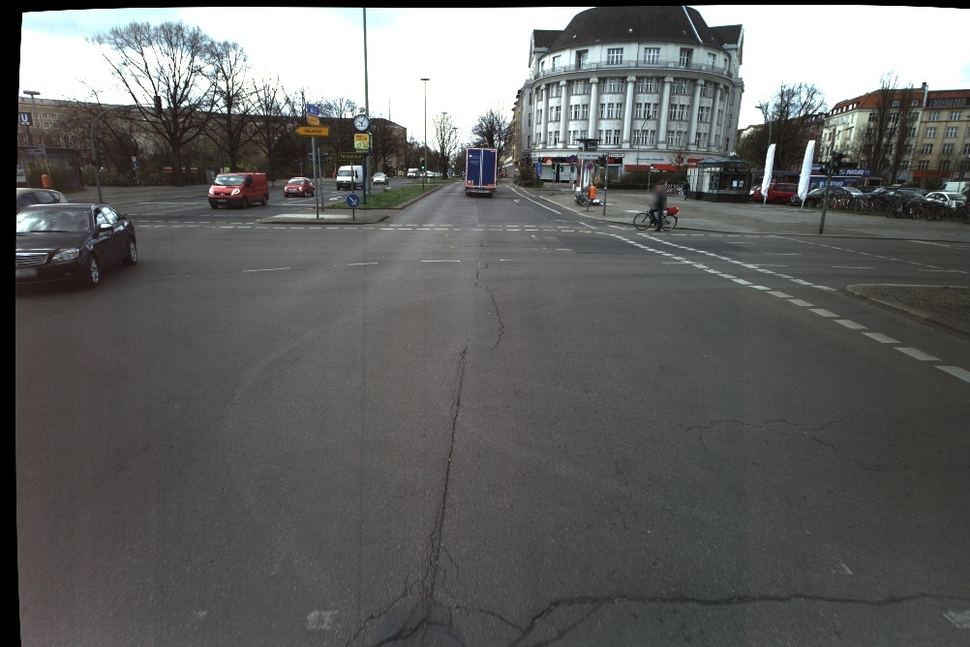
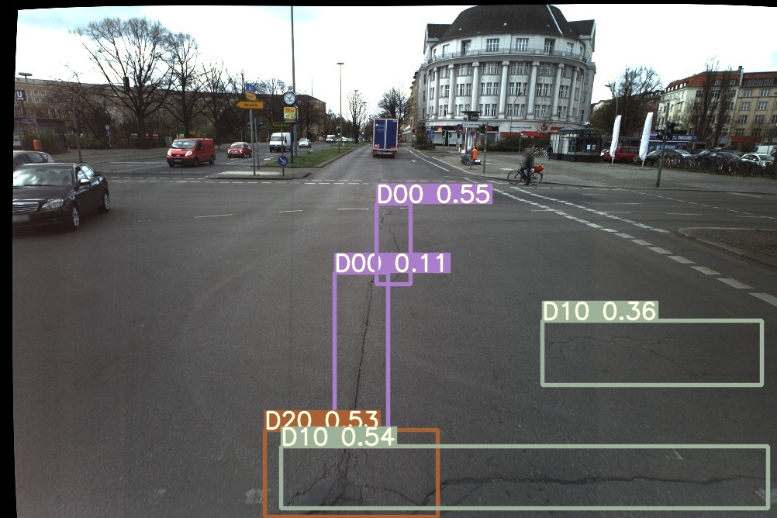
II. Implementation
iii. Road Damage Detection
● Detection Results Visualization (based on ZEB-datasets)
original img
predicted img
Speaker:Yilei Chen
Notes:
Here i show the detection results on ZEB-dataset, which is actually not bad.

Slide 11
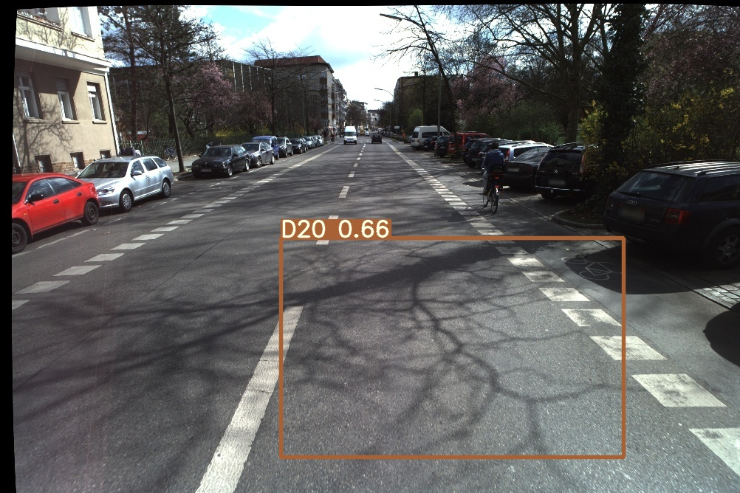
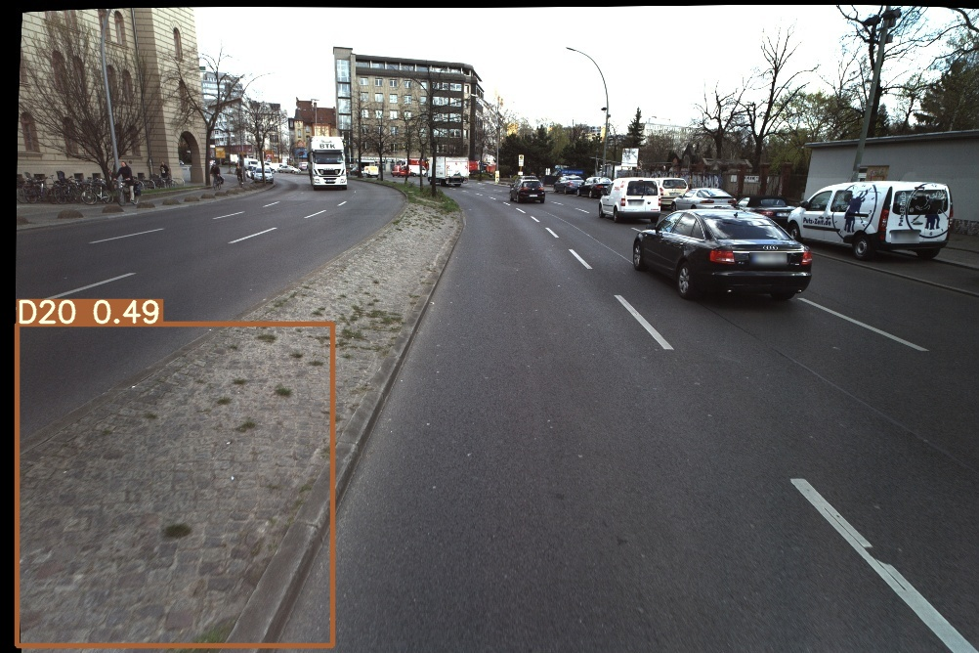
II. Implementation
iii. Road Damage Detection
● Detection Results Analysis (based on ZEB-datasets)
- Detection Error Example:
Detection Error caused by Shadow
Detection Error caused by Gravel Roads
11
Speaker:Yilei Chen
Notes:
But there are still some detection error caused by different factors. For example like the model will predict the Shadow as Alligator Crack damage. And Gravel Road which is the special feature of Berlin is also predict as Alligator Crack damage.

Slide 12
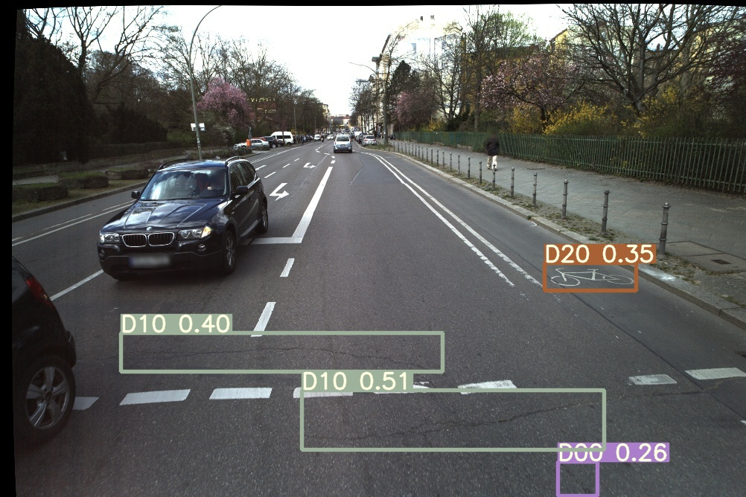
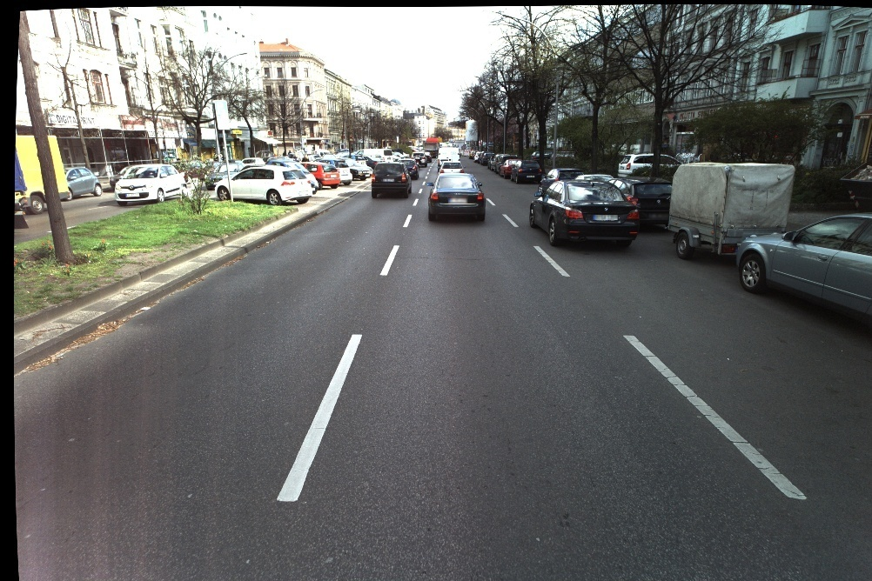
II. Implementation
iii. Road Damage Detection
● Detection Results Analysis (based on ZEB-datasets)
- Detection Error Example:
Detection Error caused by bicycle lane sign
Detection Error caused by low image resolution
Speaker:Yilei Chen
Notes:
And the bicycle lane sign as well is also predict as D20 damage. Moreover, we can see on the right picture, there is a Transverse Crack damage but due to the low image resolution the road damage could not be detected. So the Detection model is of course not good enough, there is still a long way to go.

Slide 13
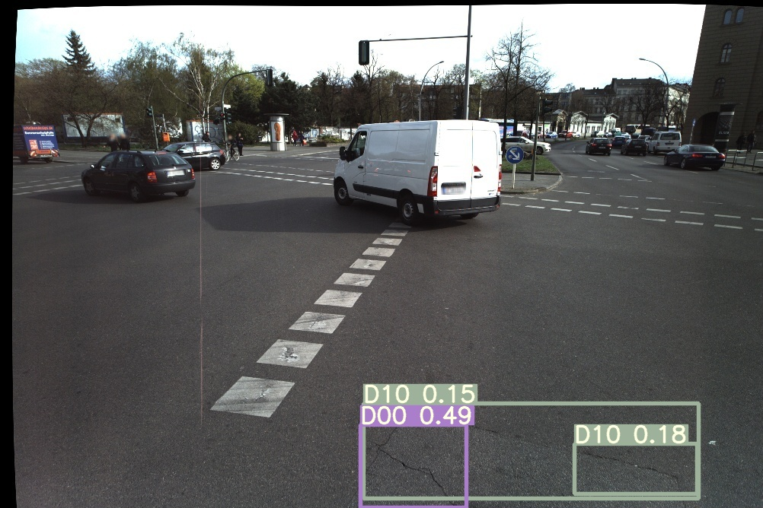
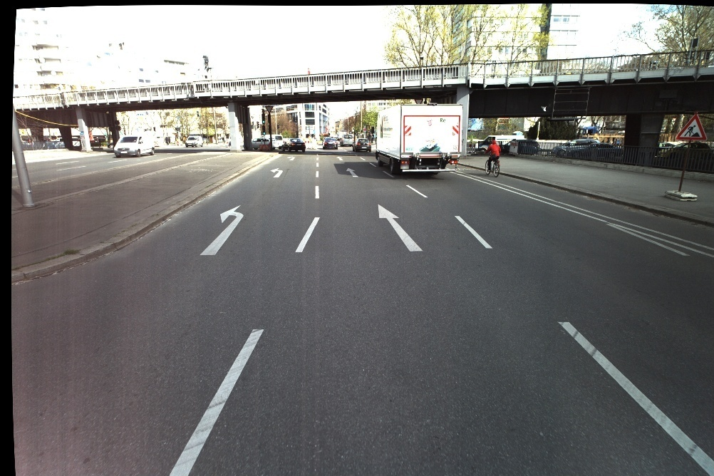
II. Implementation
iv.Preprocessing(ZEB_dataset)
● Dataset Cleaning(Denoising)
- Significant damage but twrio and zwris values are 1.
- The twrio and zwris values are large but the damage is insignificant.
twrio=1; zw ris = 1
twrio = 2.93; zw ris = 2.79
Speaker:Yilei Chen
Notes:
So in order to make the data better fit our Rating Regression model, we have done some preprocessing like datasets cleaning. Like if there are some significant damages but values of twrio and zwris are 1,which means the road is damage-free. Or the twrio and zwris values are both large but the road damage is insignificant. As for these kind of images we see it as noise and delete it from the datasets which can make the model fit better .

Slide 14
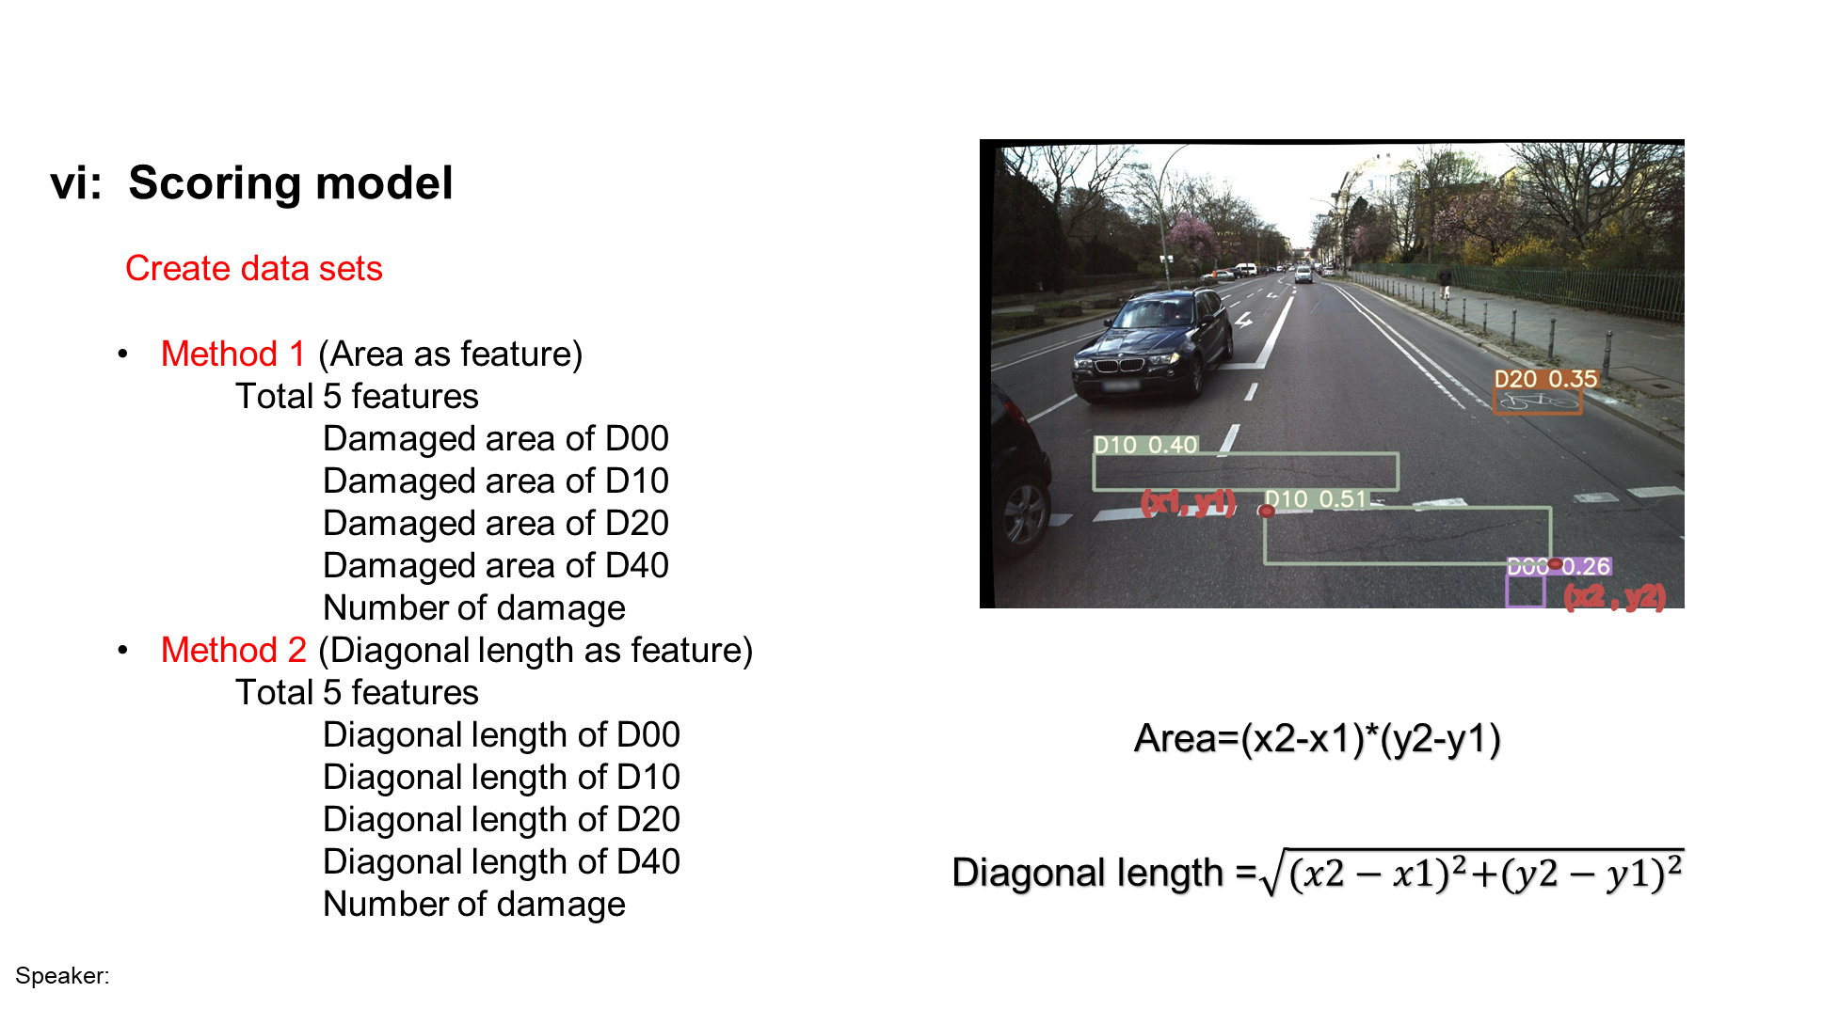
Jie Chen

Slide 15
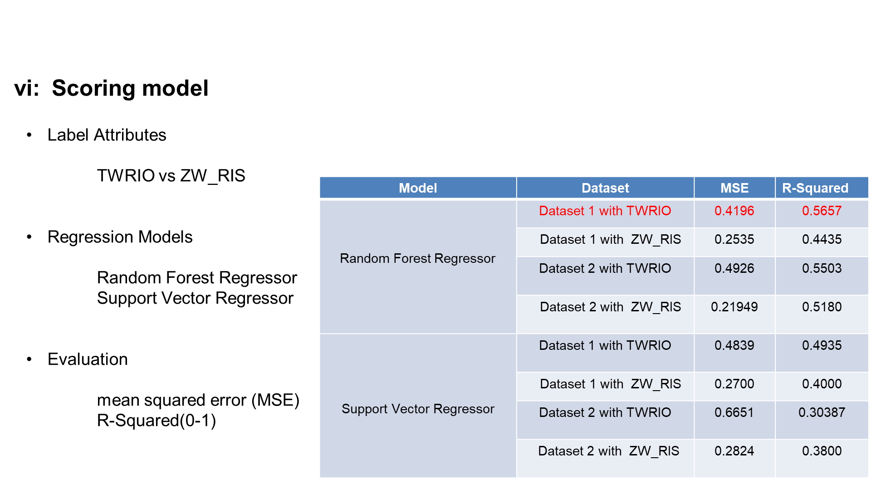
Speaker: Jie Chen

Slide 16
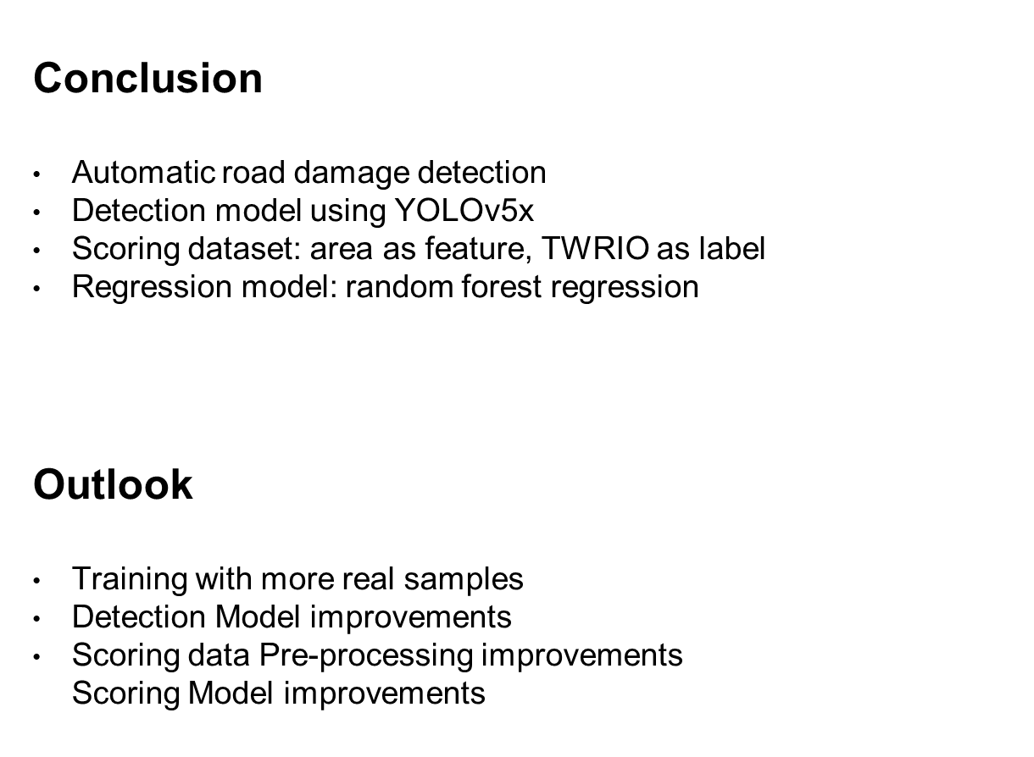
III. Conclusion & Outlook
Speaker: Jie Chen

Slide 17
Thank you for your attention!
Name: Yile Chen, Yiying Yang, Jie Chen

Slide 18
Quelle
[1] Arya, D., Maeda, H., Ghosh, S. K., Toshniwal, D., Mraz, A., Kashiyama, T., & Sekimoto, Y. (2020). Transfer Learning-based Road Damage Detection for Multiple Countries. arXiv preprint arXiv:2008.13101.

